Slide 1

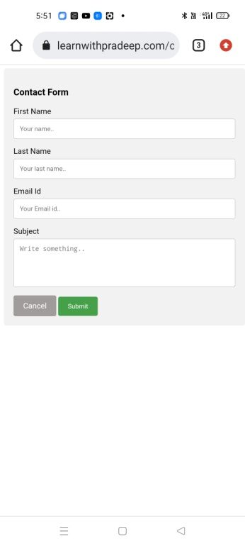
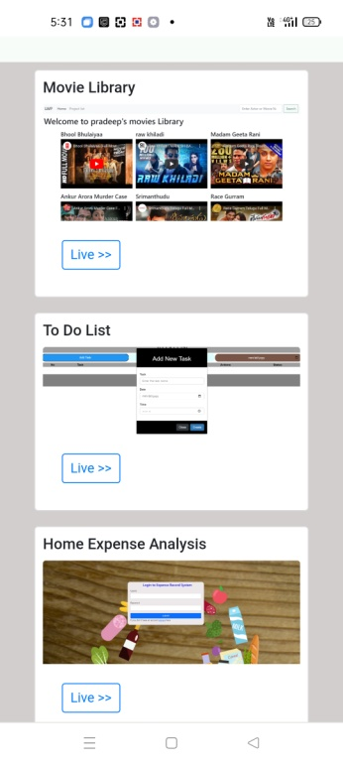
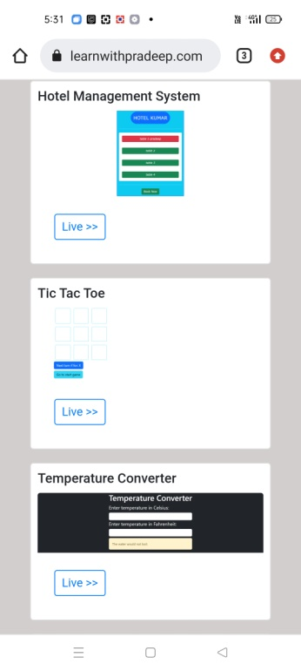
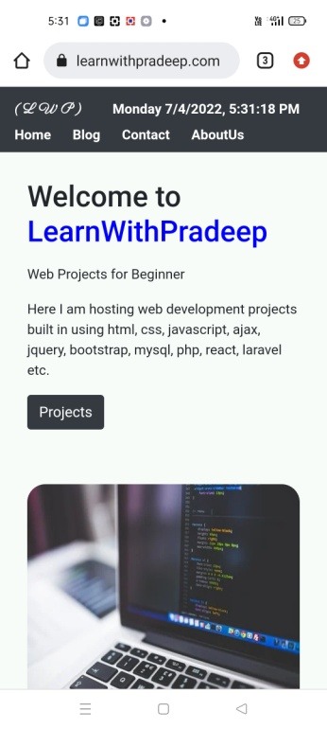
LearnWithPreadeep.com
Frontend
HTML, CSS, JS, BOOTSTRAP AND PHP
Backend
PHP, MYSQL, DEGITALOCEAN
CLOUDFLARE,

Slide 2
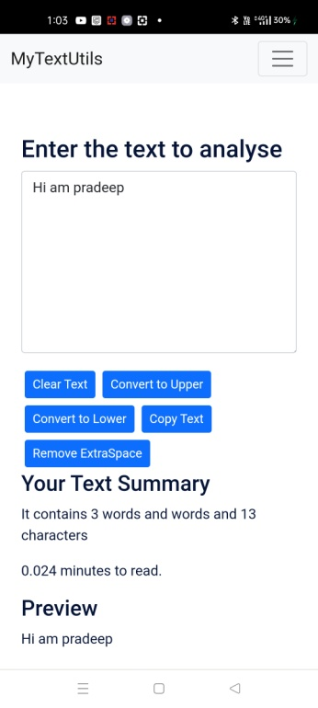
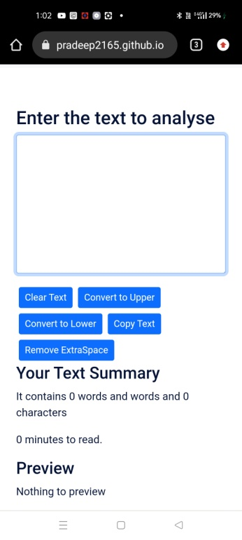
My Text Utilities
Frontend
BOOTSTRAP
Backend
REACTJS

Slide 3
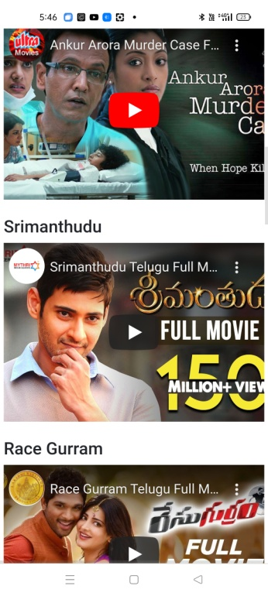
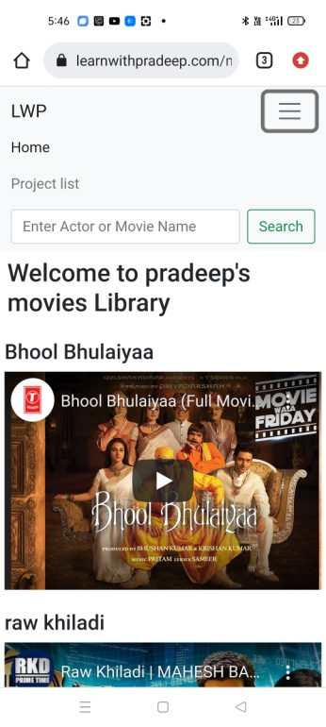
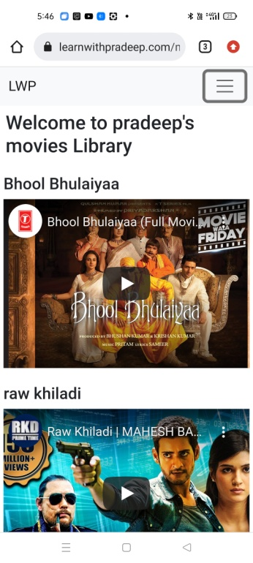
Movies Steamming
Frontend
HTML, CSS, JS, BOOTSTRAP, PHP
Backend
PHP, MYSQL

Slide 4
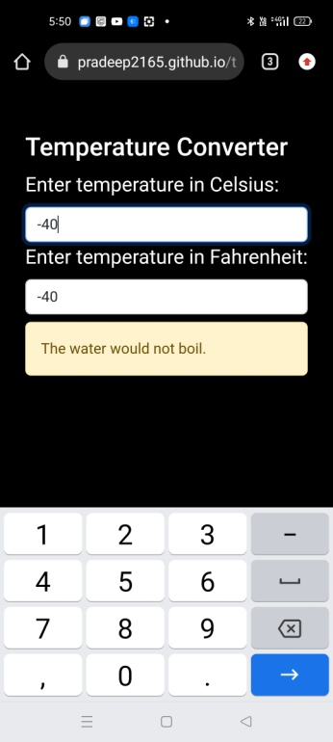
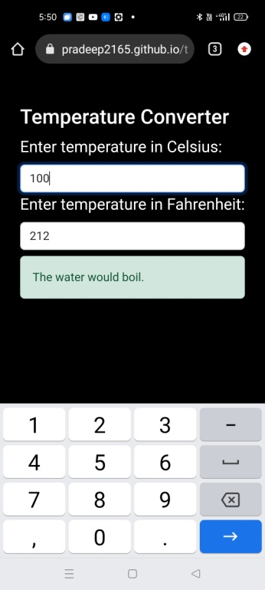
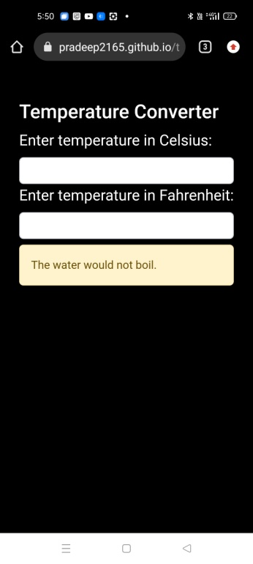
Temperature Calculator
Frontend
BOOTSTRAP
Backend
ReactJs

Slide 5
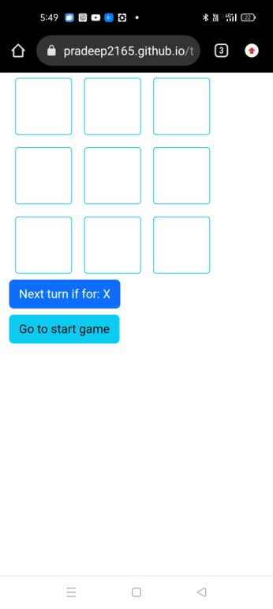
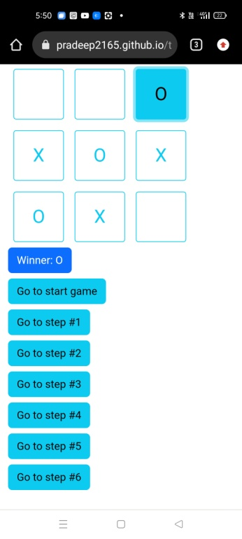
Tic-Tak-Toe
Frontend
BOOTSTRAP
Backend
REACTJS

Slide 6
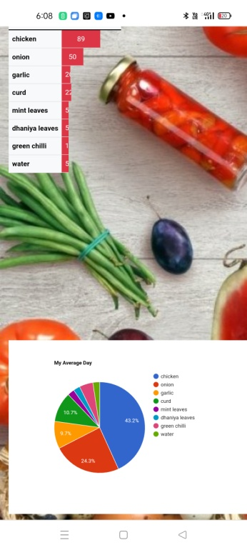
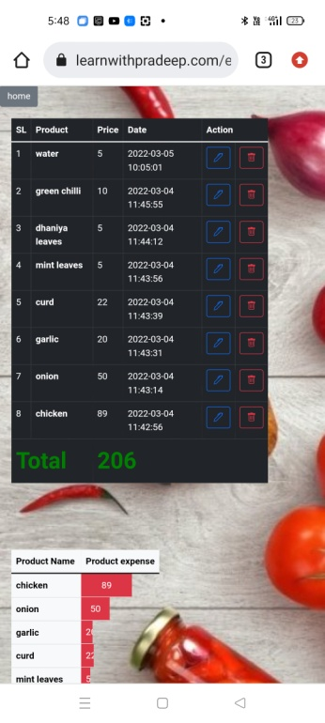

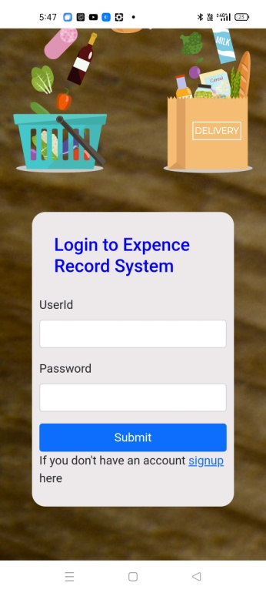
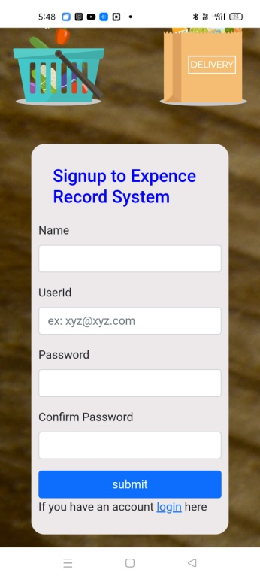
Expense Record System
Frontend
BOOTSTRAP
Backend
PHP, MYSQL

Slide 7
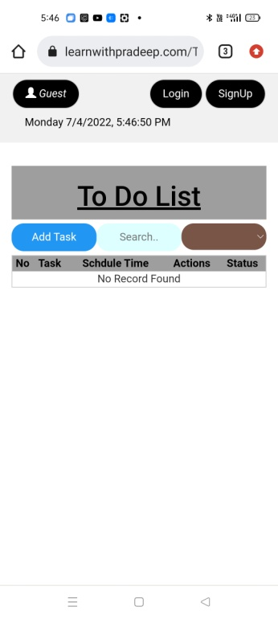
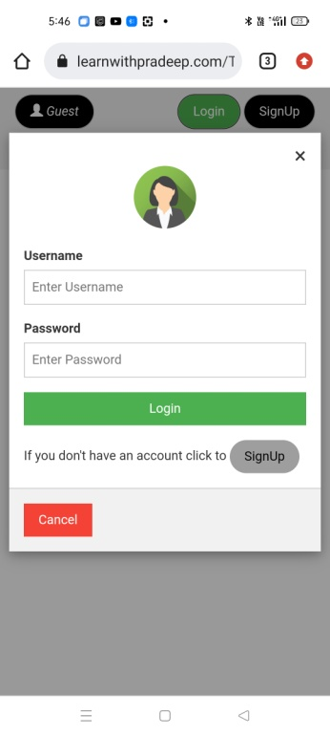
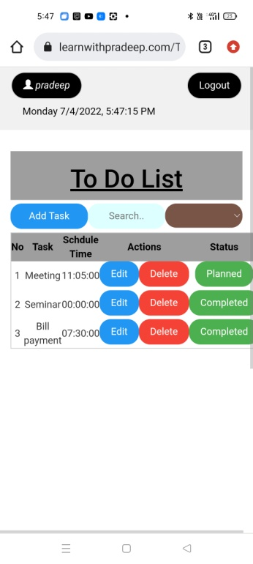
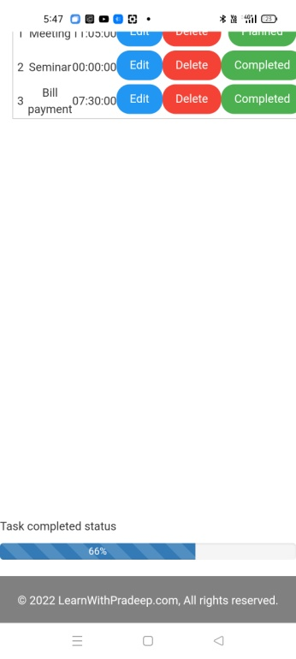
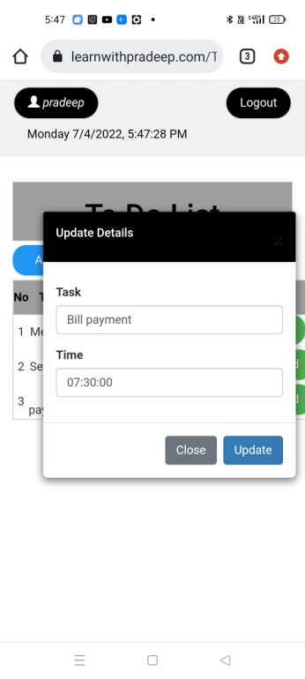
To Do List
Frontend
HTML, CSS, JS, BOOTSTRAP, AJAX,
JQUARY, PHP
Backend
PHP, MYSQL

Slide 8
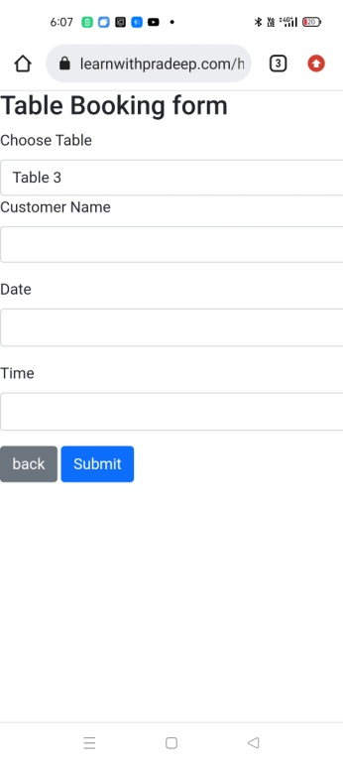
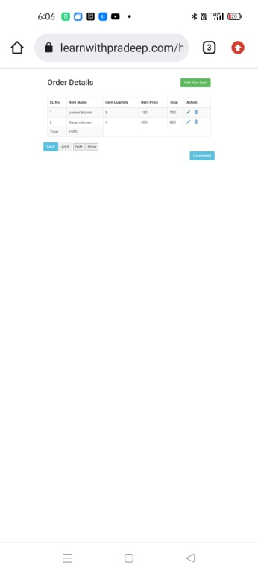
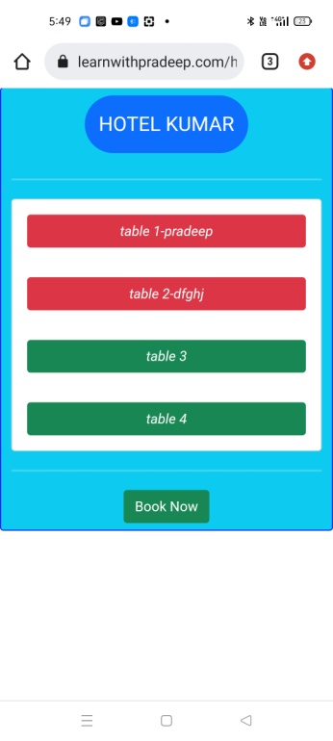
Hotel Table Booking
Frontend
HTML, CSS, JS, BOOTSTRAP, AJAX,
JQUARY, PHP
Backend
MYSQL, PHP

Slide 9
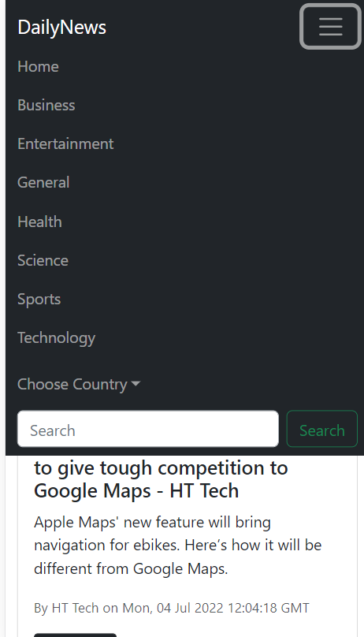

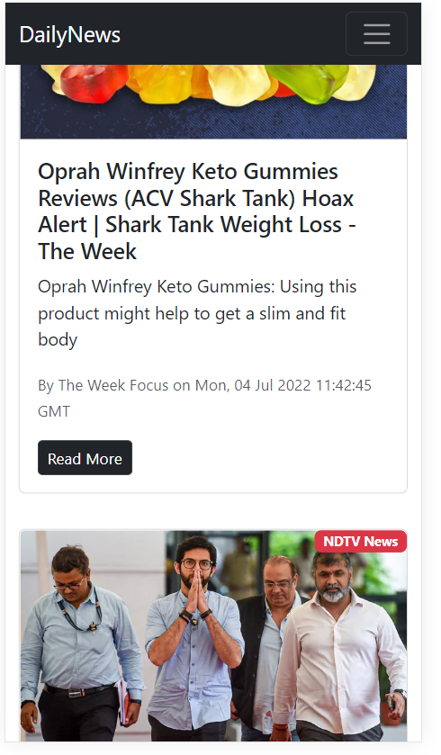
DailyNews
Frontend
Bootstrap
Backend
REACTJS, NEWAPI

Slide 10
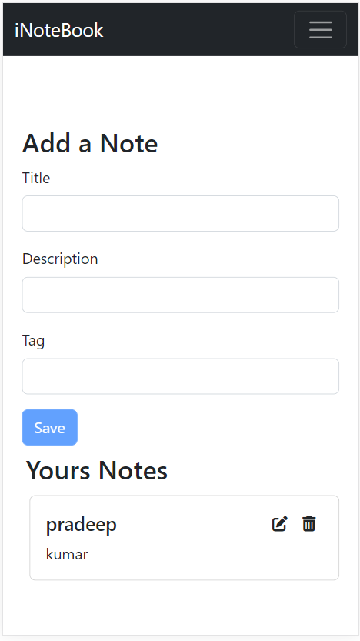
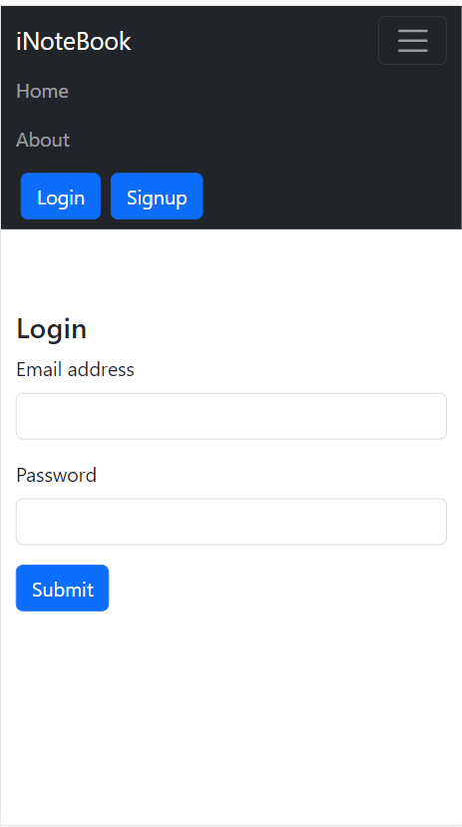
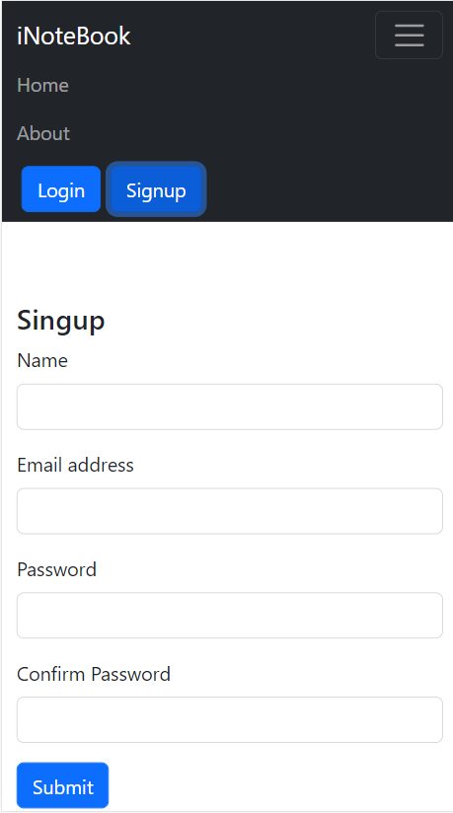
iNoteBook
Frontend
Bootstrap
Backend
REACTJS, NODEJS,
MONGODB,
EXPRESS,
AND NPM PACKAGES

Slide 11
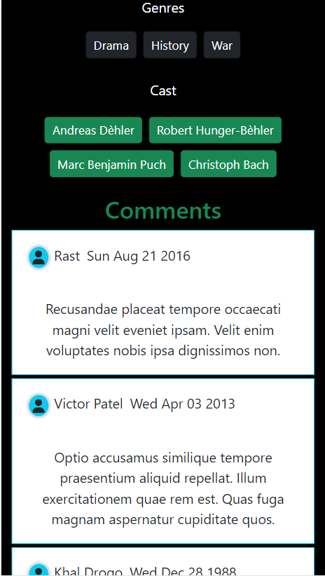
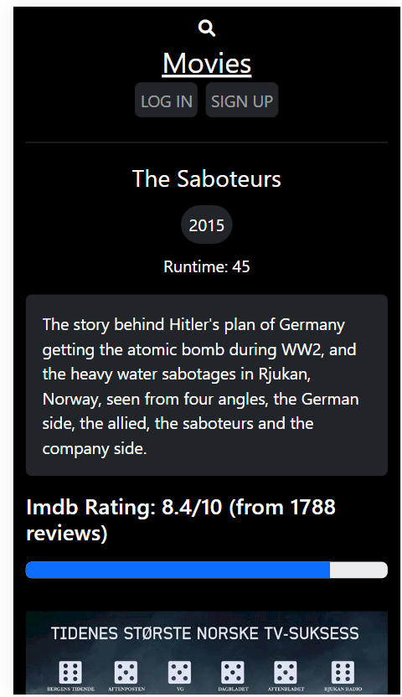

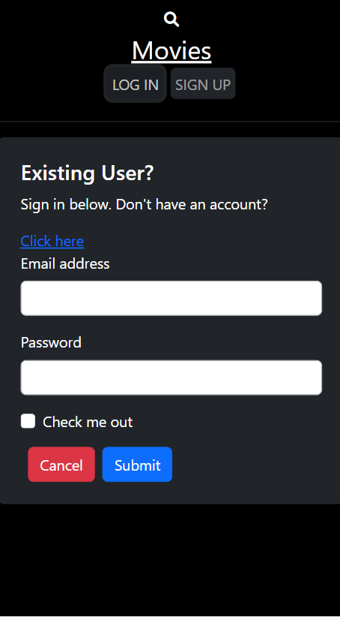
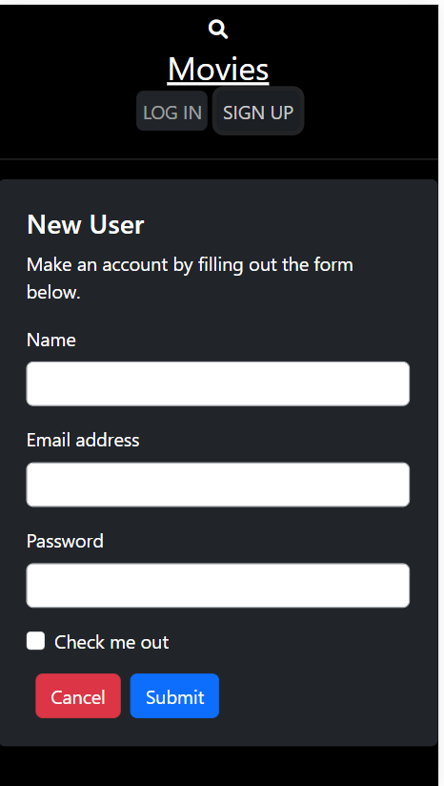

MOVIE REVIEWS COMMENTS
FRONTEND
REACTJS
BACKEND
REACTJS, MONGODB, EXPRESS
AND NPM PACKAGES

